Slide 1
AASA NCE 2024
Exhibitor Webinar 2/11/2024
Hannah Redmond, Kelsey Kwasniak

Slide 2
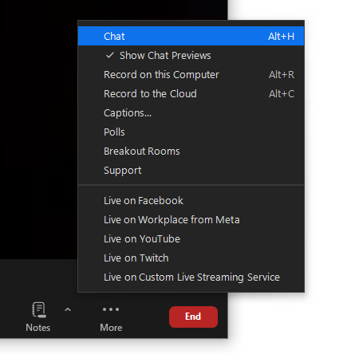
Webinar Housekeeping Tips
Reminder: All attendees can see our team as hosts but we cannot see you.
To ask a question, please type these in the chat. We will have Q&A at the end of the webinar.
This webinar is being recorded and will be posted on the NCE.AASA.org website.
Notes:
We will now be turning off our cameras during the webinar. We will come back on for Q&A at the end.

Slide 3
Agenda
Dates & Location
Registration
Hotel Information
Schedule Highlights
Event Highlights on the Exhibit Hall Floor
School of the Future
Exhibitor Lounge
Shipping Details
Booth Inclusions/Exclusions
Placing Orders with Freeman
Booth Donations
WiFi Onsite & Mobile App
Marketing Toolkit
2025 Booth Sales
How to Appeal to the NCE Attendee Audience

Slide 4
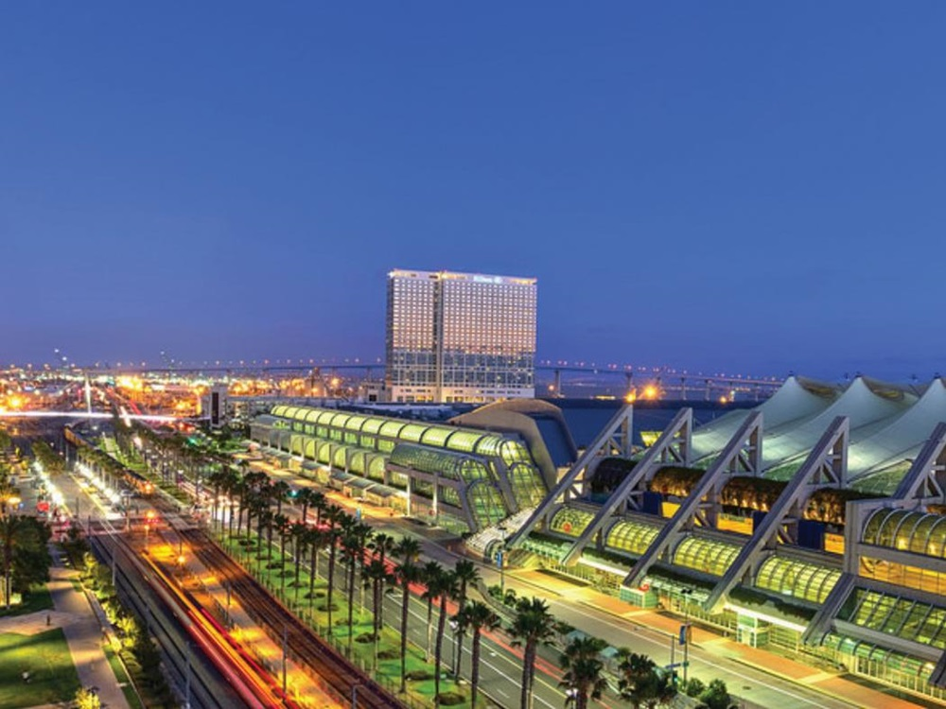
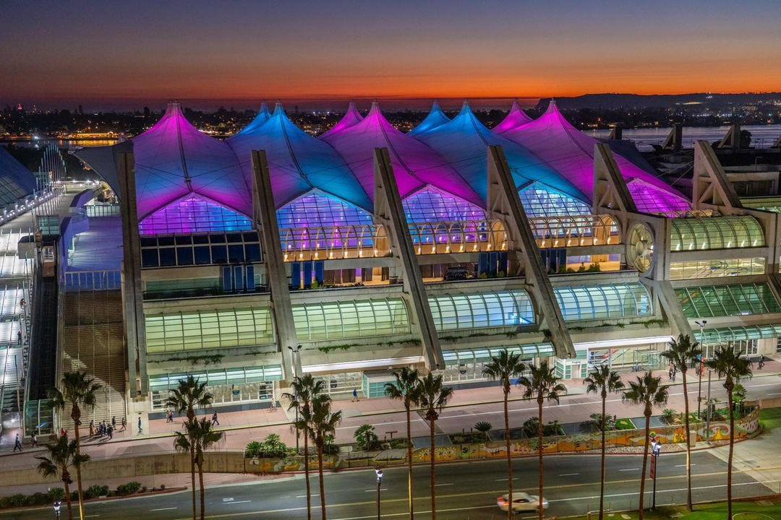
Dates & Location
NCE 2024
  February 15 – 17, 2024
  San Diego Convention Center
  111 Harbor Drive, San Diego, CA 92101
  Exhibit Halls AB

Slide 5
Registration
We highly recommend confirming registration ahead of time to prevent long wait times at the registration desk.
The registration desk will be located outside Hall AB Foyer
*Note: NCE Partners have be contacted directly for registration information.
Five (5) complimentary exhibit using hall only registrations per 100 square feet of space (or each 10' x 10' booth rented)
One (1) complimentary full conference registration per company
Please ensure your team is registered the instructions provided to your primary contact via email.
If you need instructions re-sent, please email aasasupport@cmrus.com

Slide 6
Attendee Registration Update
To date we have 2,995 paid attendee registrations
This is inline with where NCE was tracking for our 2023 event.
To date we have 327 confirmed exhibitors
Our 2024 Show Floor is SOLD OUT!

Slide 7
Hotel Information
Make your hotel reservations at the official National Conference on Education hotels, all within walking distance of the convention center.
NCE 2024 Headquarter Hotel:
  Marriott Marquis San Diego Marina
  333 W Harbor Dr, San Diego, CA 92101
Please visit: https://hsg.cmrus.com/aasa2024/GP/EXHB/Housing/Reservation

Slide 8
Schedule Highlights
Exhibitor Move In
Wednesday, February 14, 2024 – 8:00AM-5:00PM
*all exhibits must be set up by 5:00PM Wednesday, February 14
Exhibit Hall Hours
Thursday, February 15, 2024 – 7:30AM-3:30PM
Friday, February 16, 2024 – 11:00AM-2:30PM
Exhibitor Move Out
Friday, February 16, 2024 – 2:30PM-6:00PM
*all exhibits must be moved out by 6:00PM Friday, February 16

Slide 9
Event Highlights on the Exhibit Hall Floor
Social Media Lounge – (Booth 1422)
  Sessions, training and interactions with education leaders who leading the way on social media.
Roundtable Sessions – (Booth 1354)
  Interactive (1) hour sessions for hands on conversations on key topics for superintendents
Health & Wellness Center – (Booth 737)
  Relax & Re-Charge by visiting the dog petting lounge, personal massages, electric bike smoothies or enjoy snacks & refreshments
Knowledge Exchange Theatre – (Booth 654)
  Sessions featured on the floor for critical topics in the public education field.
School Safety & Security Lab – (Booth 1435)
  New this year! Stop by to learn more about safety & security in schools.
Notes:
The School Safety & Security Learning Lab is within our exhibit hall. This educational opportunity will allow attendees to walk and learn at their own pace in a self-guided experience. Visitors can spend time in our Learning Lounge as well to talk to partners who supply solutions vital to school safety and security.

Slide 10
School of the Future
Located in Booth #617
Learn about out-of-the-box products and services offered by exhibiting companies.
Schedule can be found on the NCE Mobile App and in the Conference Program
There will also be pre-recorded School of the Future videos available on nce.aasa.org
If you’re presenting a School of the Future session, please ensure to arrive 10 minutes before your session to prepare.

Slide 11
Exhibitor Lounge
Stop by Booth 228 to relax & re-charge with snacks and refreshments for all exhibit booth staff.
Lounge will be open during show hours on Thursday, February 15 and Friday, February 16.
Sponsored by Classlink

Slide 12
Shipping Details – Advanced Warehouse
Our Advance Warehouse Shipping deadline is February 7. Note the Advanced Warehouse address below. All advanced shipments will be dropped in your booth before move in begins on Wednesday, February 14 at 8:00AM.
Select larger booths may be moving in earlier on Tuesday, February 13. If you have a space 20x20 or larger, please contact kkwasniak@smithbucklin.com for any questions.
    Exhibiting Company Name / Booth #
    2024 AASA National Conference on Education
    C/O Freeman
    3456 E Miraloma Ave
    Anaheim, CA 92806 USA

Slide 13
Shipping Details – Direct to Show Site
Last minute shipments to the show site should not arrive to the convention center prior to 8:00am on Wednesday, February 14, 2024. Any shipments arriving before this date may be refused by the facility. Any charges incurred for early freight accepted by the facility are the responsibility of the Exhibitor.
    Exhibiting Company Name / Booth #
    2024 AASA National Conference on Education
    San Diego Convention Center
    C/O Freeman
    111 W Harbor Drive
    San Diego, CA 92101 USA

Slide 14
What’s Included in My Booth?
Pipe and drape to outline your booth
  Island booths will not have any pipe/drape as you will be open on all 4 sides
Five (5) complimentary exhibit passes per 100 square feet of space (or each 10' x 10' booth rented)
One (1) complimentary full conference registration per company- can now be shared with your full team onsite so everyone can take advantage of additional networking!
Company identification sign
24-hour perimeter security
Listing in the Conference Program (Exhibitor is responsible for ensuring information is accurate and current. All update requests are subject to production deadlines and may not be able to be updated in the Conference Program).
AASA will email exhibitor list to attendees pre-show and again post-show to help with awareness.

Slide 15
What’s NOT Included in My Booth?
Mandatory carpet or floor covering (Required — no exceptions!)
  Flooring can be ordered via Freeman’s Service Kit website or you may bring your own flooring (as long as it covers the entirety of your space).
Mailing list
Lead retrieval/badge scanners
Tables, chairs or other furnishings
Electricity
Internet or phone connection
Any other exhibit-related items that are not listed in “What’s Included in My Booth?”

Slide 16
How do I Place Orders for my Booth?
Review the Freeman Service Kit provided in our most recent exhibitor newsletter. Also linked HERE.
While your team is onsite, if you have any questions regarding furniture, electrical, internet, or other services for your booth, please stop by the Freeman Service Kit located next to the Sales Booth on the far right of the hall (near Booth 123)

Slide 17
Booth Donations
San Diego Convention Center participates in a donation program for any exhibitors wanting to donate the following post-event: TVs, tables, chairs, misc. furniture, pens/pencils, bags, binders, books and notebooks.
To setup a donation, please contact SDCC at 619.977.0009 or email boothcleaning@visitsandiego.com
The cleaning team will have a service desk next to Freeman’s Service Desk on the far right side of the Hall near booth 123.

Slide 18
WiFi Onsite & Mobile App
Wi-Fi will be available throughout the convention center.
  Network Name: NCE24
  Password: AASANCE24
  Note: Case Sensitive
Download the NCE mobile app to your device by searching ‘NCE 2024’.
  Use this to have the most updated schedule, exhibit hall floorplan and more!

Slide 19
Marketing Toolkit
As a perk of exhibiting, we offer an online tool-kit for confirmed exhibitors that can be used to market to conference attendees.
Download here: https://nce.aasa.org/exhibitor-marketing-toolkit/
Includes web banner ads, sample social media posts, sample email or letter to your customers/prospects, and press tips.

Slide 20
2025 Booth Sales
NCE 2025 – Ernest N. Morial Convention Center, New Orleans, LA, March 6-8, 2025
Details will be provided via email to primary trade show contacts for those that have participated in NCE previously to select their space before heading onsite.
  Emails will be sent the week before NCE to all primary contacts.
Come to Booth 123 starting on Thursday, February 15 during your scheduled time to select space. On Friday during show hours, exhibitors may stop by (first come, first serve) to pick their space.

Slide 21
How to Appeal to NCE Attendees
Your Main Audience: Superintendents
The AASA National Conference on Education is the only conference where you get the chance to meet superintendents from all 50 states.
Superintendents oversee an annual spending budget of over $602 billion.
They are the CEO’s of their districts and are responsible for all purchases made at the district level.
These purchases are typically made in bulk – meaning they make large purchases for many schools at one time.

Slide 22
How to Appeal to NCE Attendees
When making plans for the conference: “Send Your Best Sales People!”
A superintendent has very little time so when you get the chance to be in front of them make it count. Staff need to be engaging and actively working to talk to a superintendent
Be sure to ask them about their district size. Determine if the superintendent directly handles district purchase or if they have a procurement office/staff. Many large districts do. You’ll want to get the contact information

Slide 23
How to Appeal to NCE Attendees
Some deals are made on the exhibit hall floor, but most are made from relationship building.
Strategic follow up is very important. Be sure to set times for follow up calls and correspondence (either with the superintendent or their procurement team).
Superintendents have suggested having a sheet where they can provide the correct contact. Be sure and have one in your booth

Slide 24
How to Appeal to NCE Attendees
Superintendents have told us the best way to tap their interest is for a company to “effectively convey what can be done for them – like reduce their healthcare costs”
Make sure you convey this through signage etc. Make this point so people can see it from a distance in the hall

Slide 25
How to Appeal to NCE Attendees
Do Your Homework!
  Be sure and learn what’s going on in public education before you arrive on site.
  Superintendents are most engaged by someone who understands their challenges. Know “what keeps a superintendent up at night”
  Tie their challenges back to the service or product that you offer.
  To learn more about the issues facing superintendents go to the Education Commission of the States website at https://www.ecs.org/.

Slide 26
Q&A
Feel free to contact us with any questions
We look forward to seeing you in San Diego soon!
Kelsey Kwasniak
Exhibits & Advertising Manager
kkwasniak@smithbucklin.com
Hannah Redmond
Exhibits & Advertising Coordinator
hredmond@smithbucklin.com
Kathy Sveen
VP of Sales
Ksveen@smithbucklin.com

